Slide 1
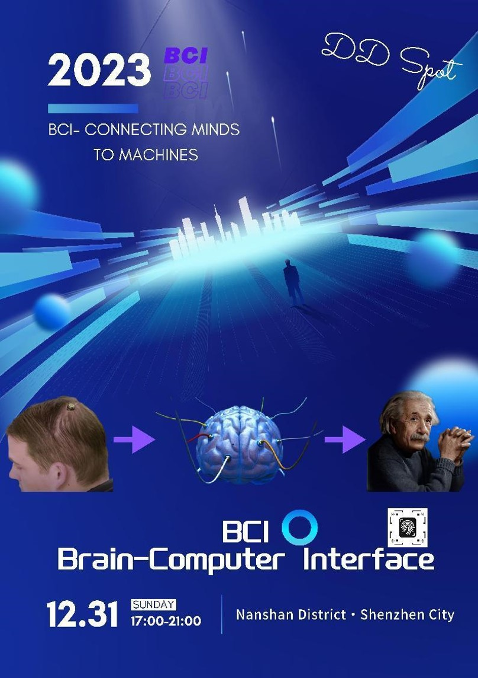
My product is called Knowledge Injector,which is a equipment that affects your brain waves and can transmit knowledge to you after injection. For those who want to gain knowledge in a short time or strengthen memory and avoid forgetting, this device will be very helpful. Its shape is similar to a bottle cap, with a diameter of 3 centimeters and a height of 1.5 centimeters. The way it work is not very hard.First, it should be taken by somebody thougtout your head and scans your head to determine the location and shape of your brain. It would identify the area of the brain involved in memory and locate the injection. Then, it concentrated his energy and opened a void hole at the injection site. Finally, locally stored knowledge(can be updated online) is injected into your brain in the form of electromagnetic waves. After it has completed its function,although you may feel a little dizzy at first, you will soon recover and feel uplifited. Actually, we need to use it at the right age. Since it has a certain impact on the brain, we can't use it too early. We must use it appropriately. All in all,if you are struggling with the final exams,just buy it.You will never be disappointed!

